Slide 1
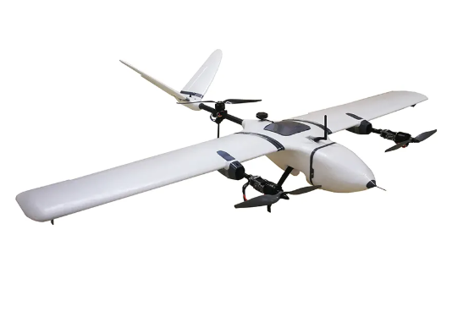
Vertical Take-off Landing (VTOL) Aircraft
Metin Öz Harun Üner Ömer Karataş
2019405000 2019405207 2019405xxx

Slide 2
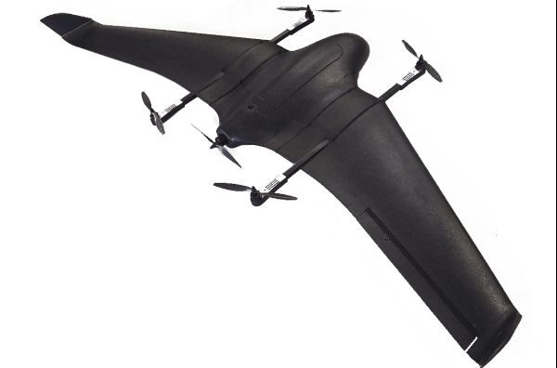
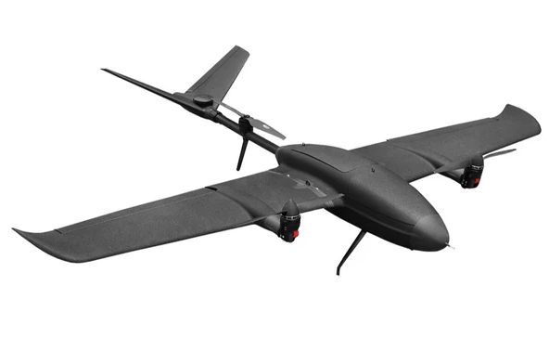
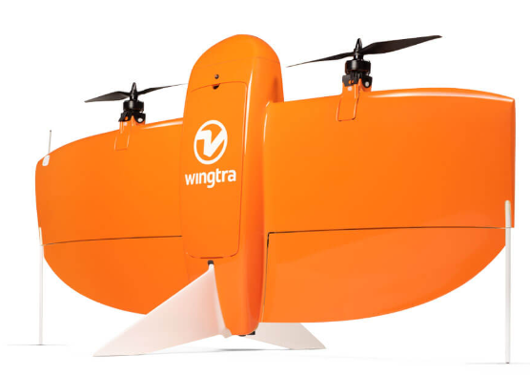
What is VTOL?
-VTOL is a type of aircraft that can take off and land vertically and also perform forward flight like a fixed wing.
-The Types of fixed-wing VTOLs :
Quad-in-Plane VTOL drones
Tail-sitter VTOL drones
Tiltrotor VTOL drones

Slide 3
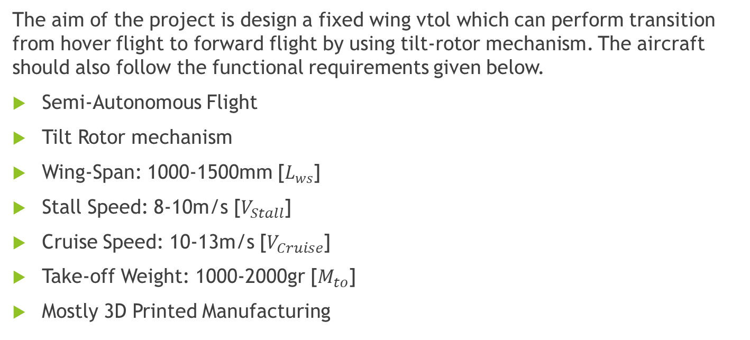
Problem Definition and Functional Requirements :
The aim of the project is design a fixed wing vtol which can perform transition from hover flight to forward flight by using tilt-rotor mechanism. The aircraft should also follow the functional requirements given below.
Semi-Autonomous Flight
Tilt Rotor mechanism
Wing-Span: 1000-1500mm [$L_{ws}$]
Stall Speed: 8-10m/s [$V_{Stall}$]
Cruise Speed: 10-13m/s [$V_{Cruise}$]
Take-off Weight: 1000-2000gr [$M_{to}$]
Mostly 3D Printed Manufacturing

Slide 4
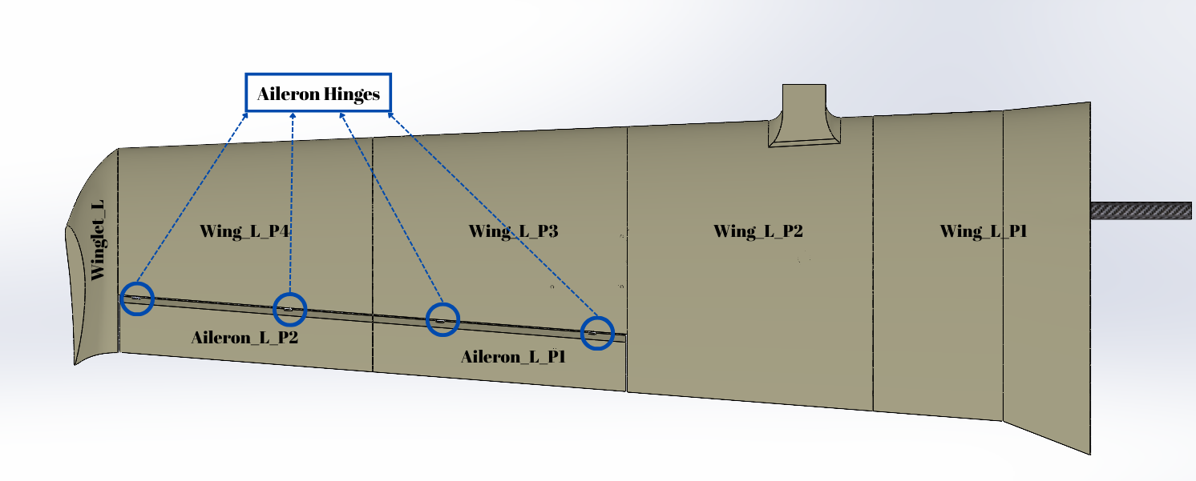
Parts of the Wing Section
There are 7 sections to be 3D Printed for each wing

Slide 5
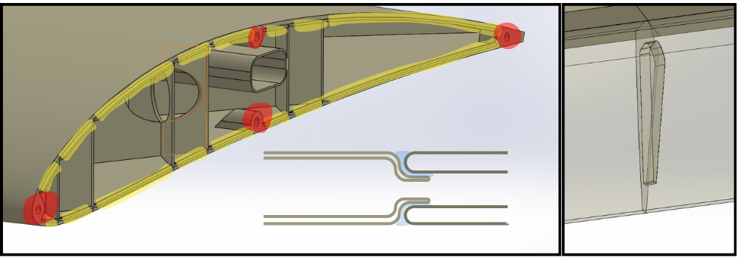
Aileron Connection Lugs
Snap-Joint connection tabs are indicated as yellow.
-Creates larger surface areas for adhesives
-Prevents collapse of walls at connectios
Pin holes are indicated as red.
-They are designed to fit 1.75mm filament pins
-Simplifies alignment and creates strong attachment points

Slide 6
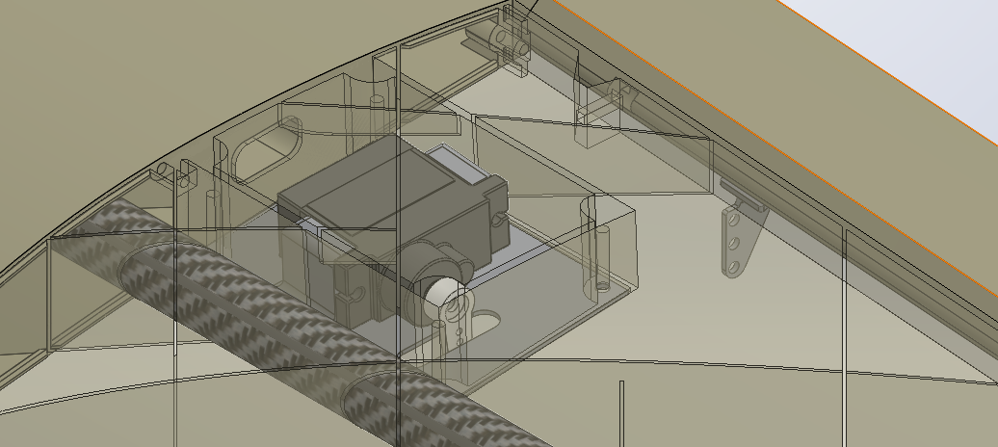
It is designed a cavity and cap for servo controller.
It prevents the servo from being exposed and reduces surface distortion.
It creates an accessible workspace for operations such as servo replacement.

Slide 7
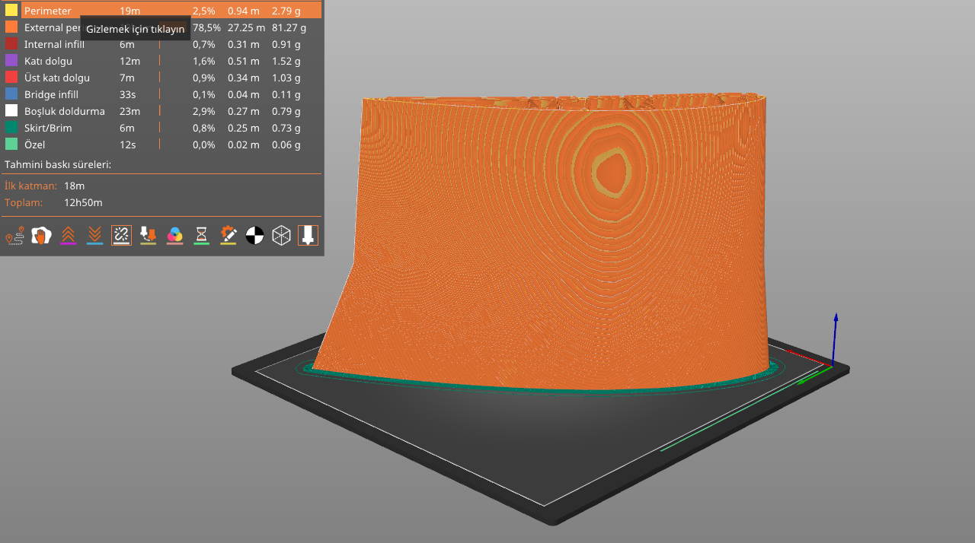
Ender 3-S1 and Prusha Slicer is chosen as printing instruments
Ender 3-S1 is an open-frame 3D printer with working volume of 220x220x270, it is considered sufficient for production with pla material.
Prusha Slicer was preferred because of more satisfactory results in the fields of seam hiding and surface quality.

Slide 8
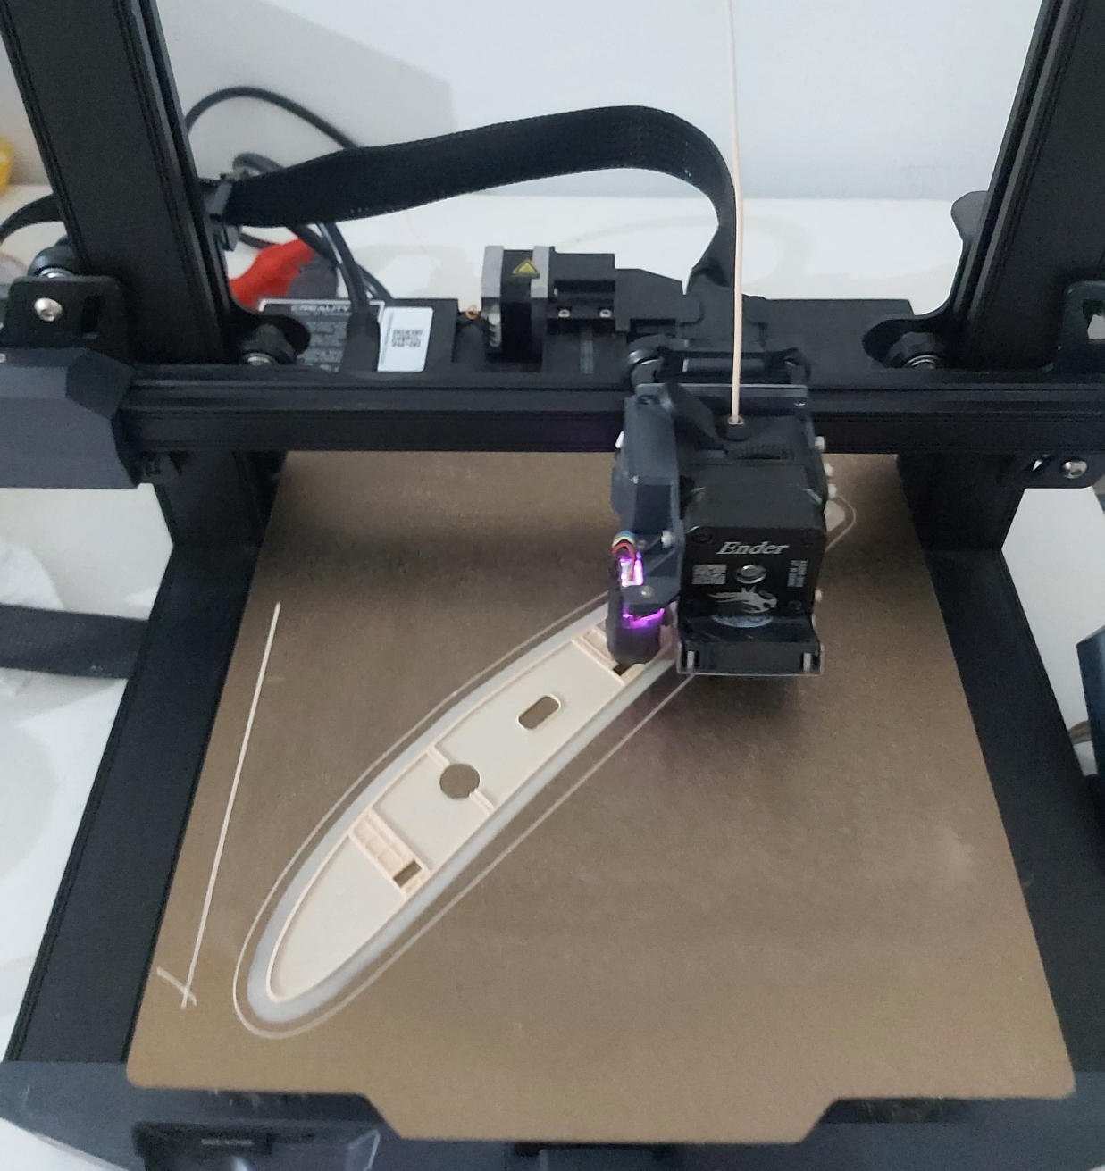
Printing Times of the parts
Wing_L_P1 | 12h 50min
Wing_L_P2 | 12h 12min
Wing_L_P3 | 9h 26min
Wing_L_P4 | 7h 47min
Winglet_L | 2h 15min
Aileron_L_P1 | 3h 16min
Aileron_L_P2 | 3h 20min
Total (x2) | 102h 12min

Slide 9
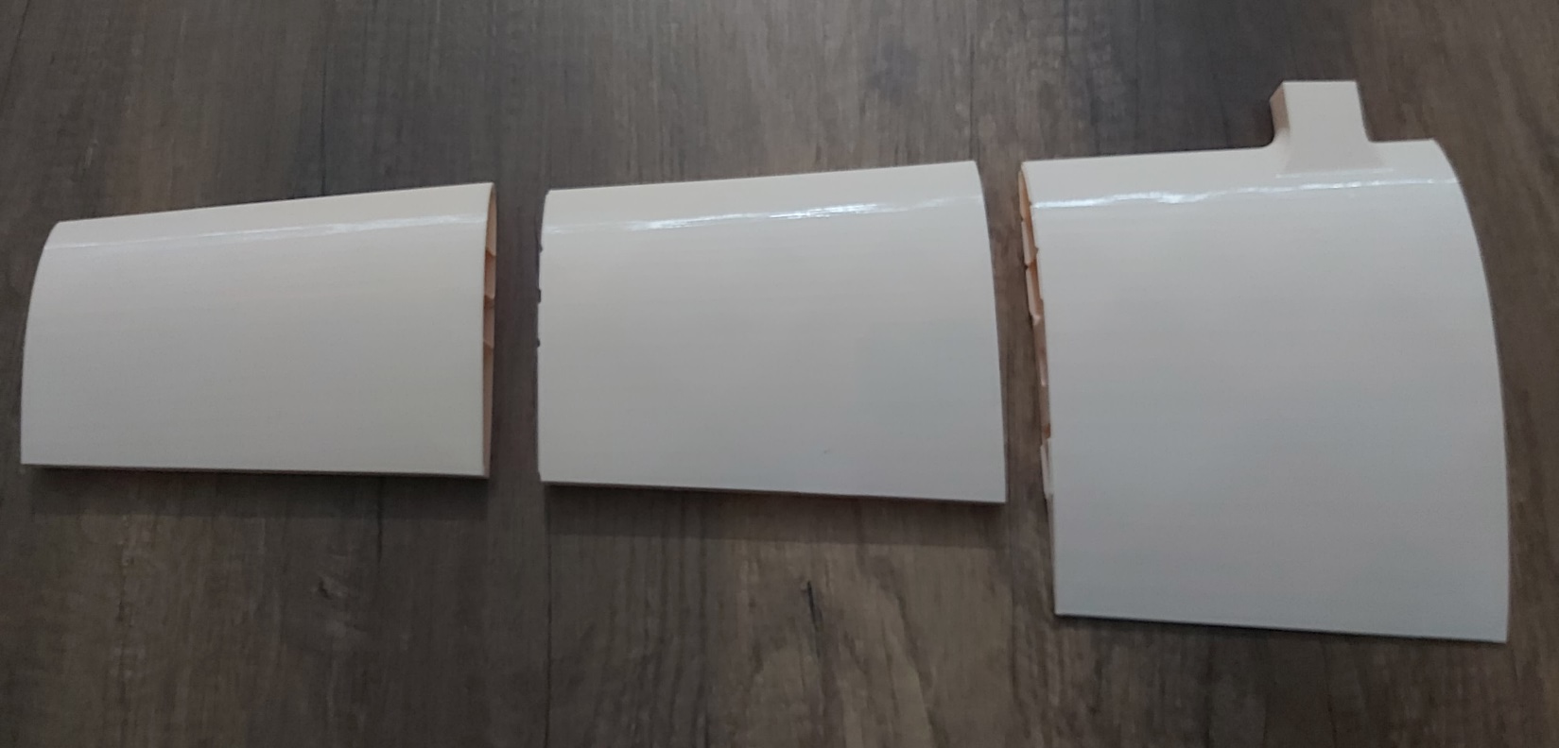
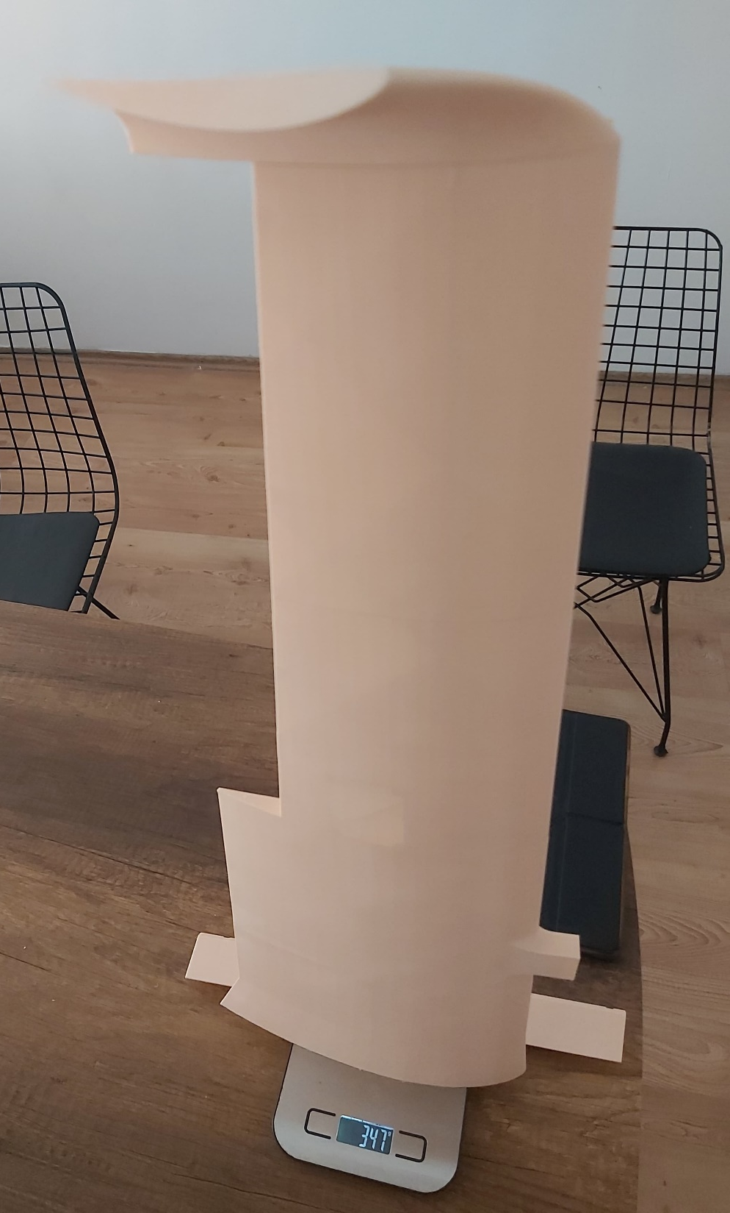
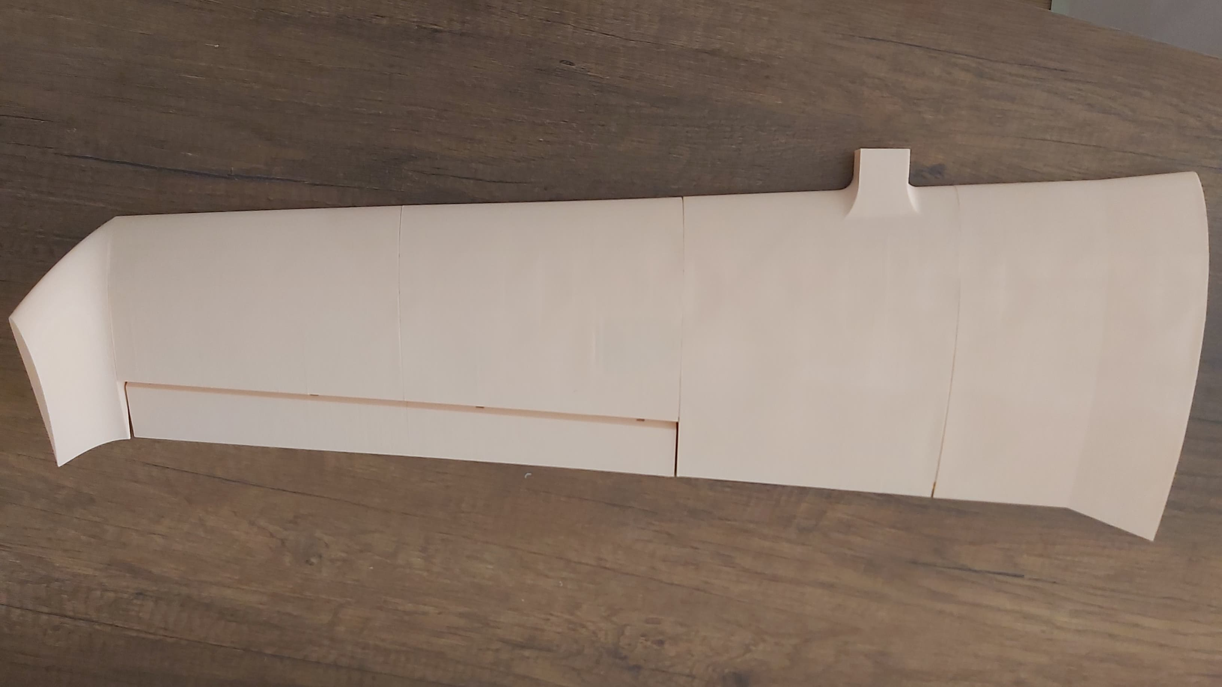
One side of the printed wing weighs only 347g
Not glued only snap joint holds them together

Slide 10
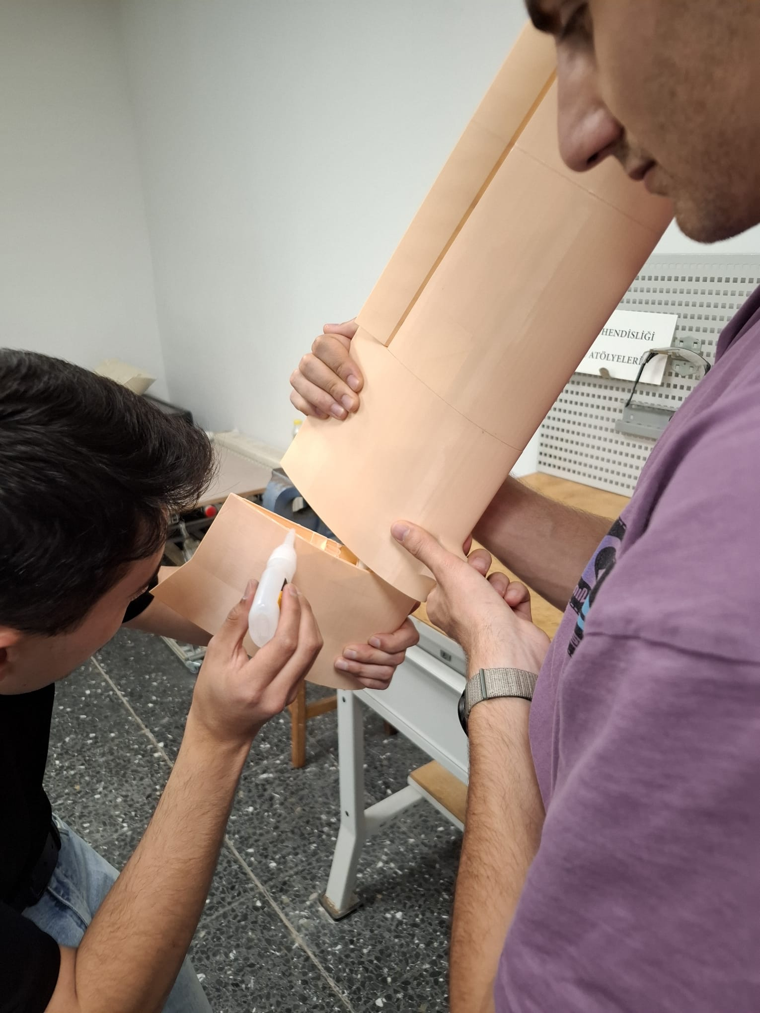
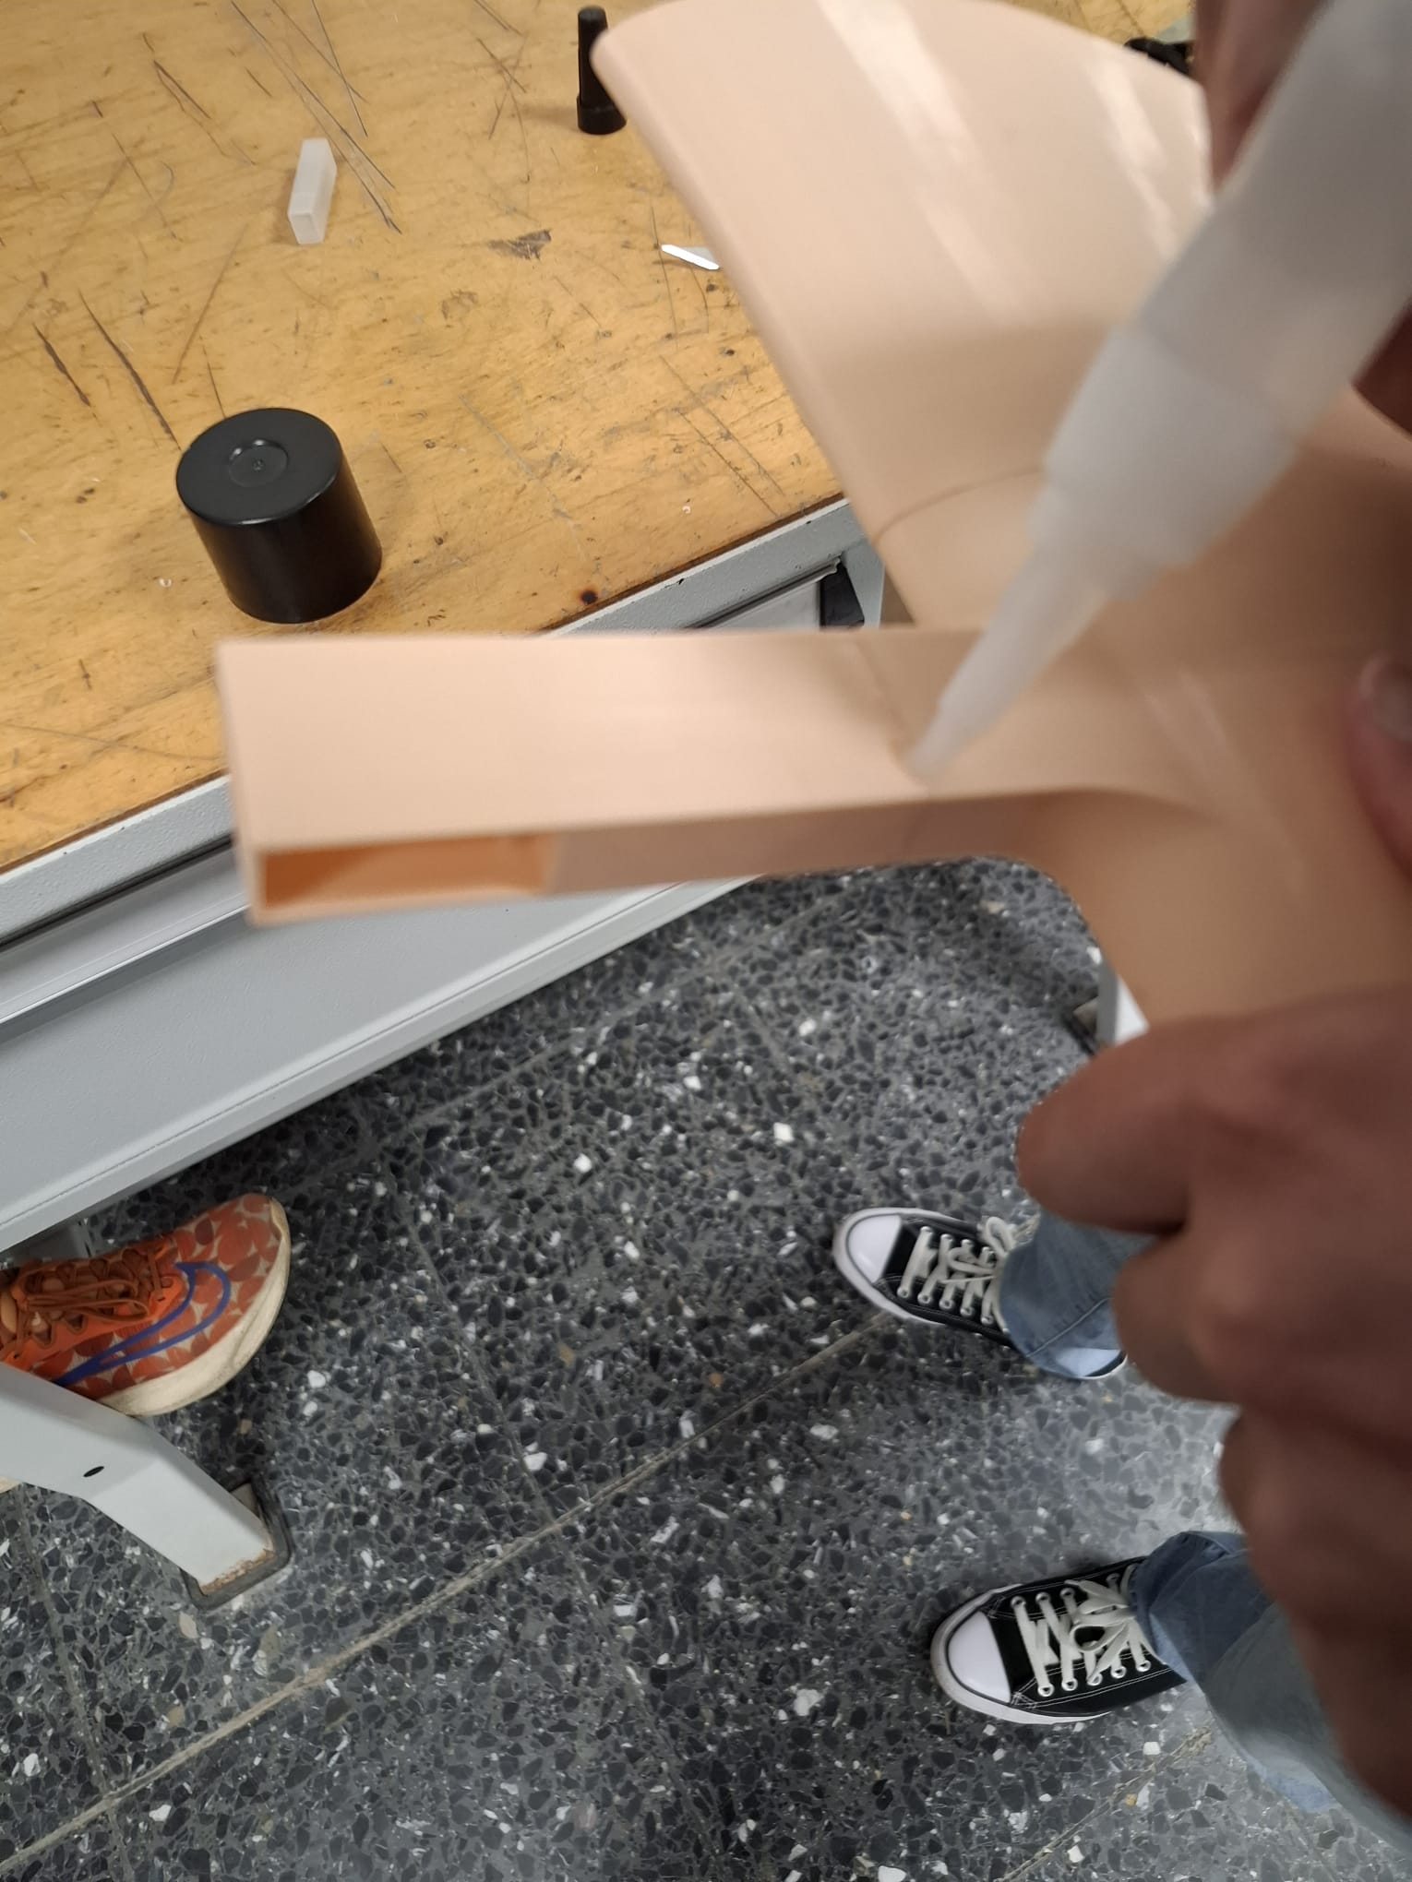
Assembly of Wing
Gluing wing parts
Gluing wing arm
Parts are aligned using pins.
Attached together using glue.

Slide 11
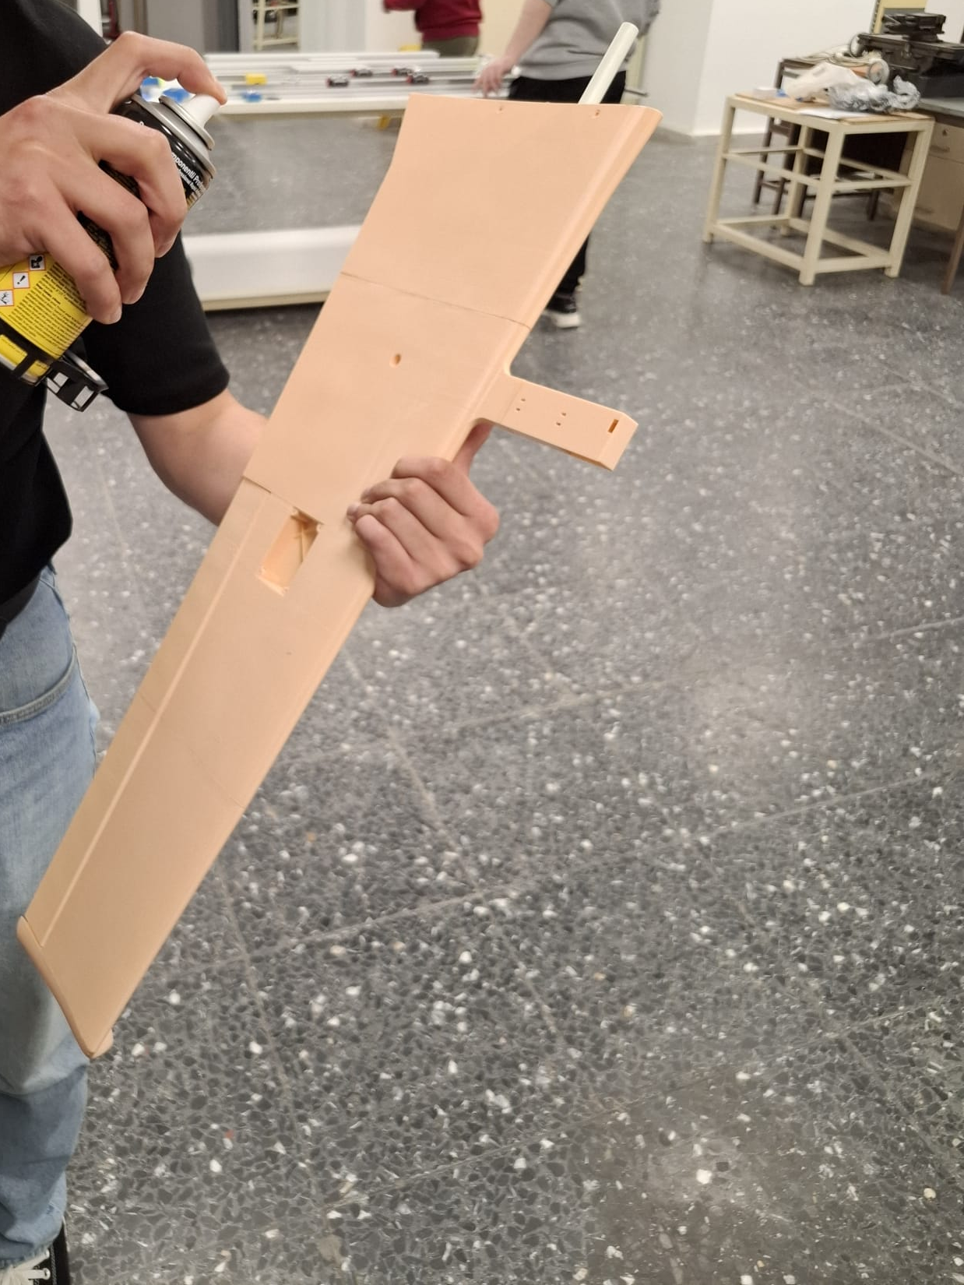
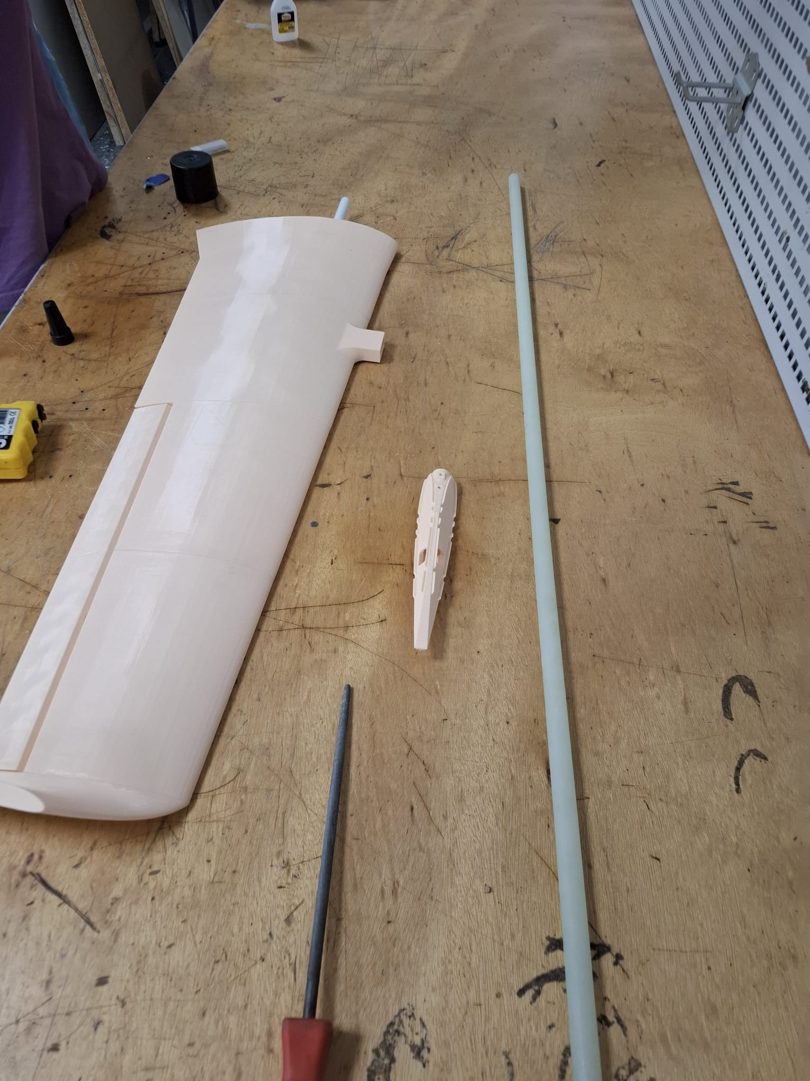
Assembly of Wing
Two part glue activator
Assembled wing
Two part glue is used for attaching parts.
Glass fiber pipe is added.

Slide 12
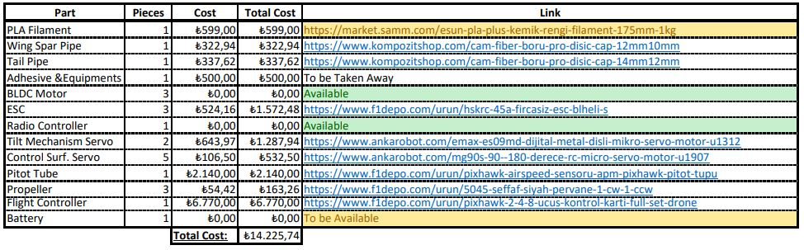
Cost analysis

Slide 13
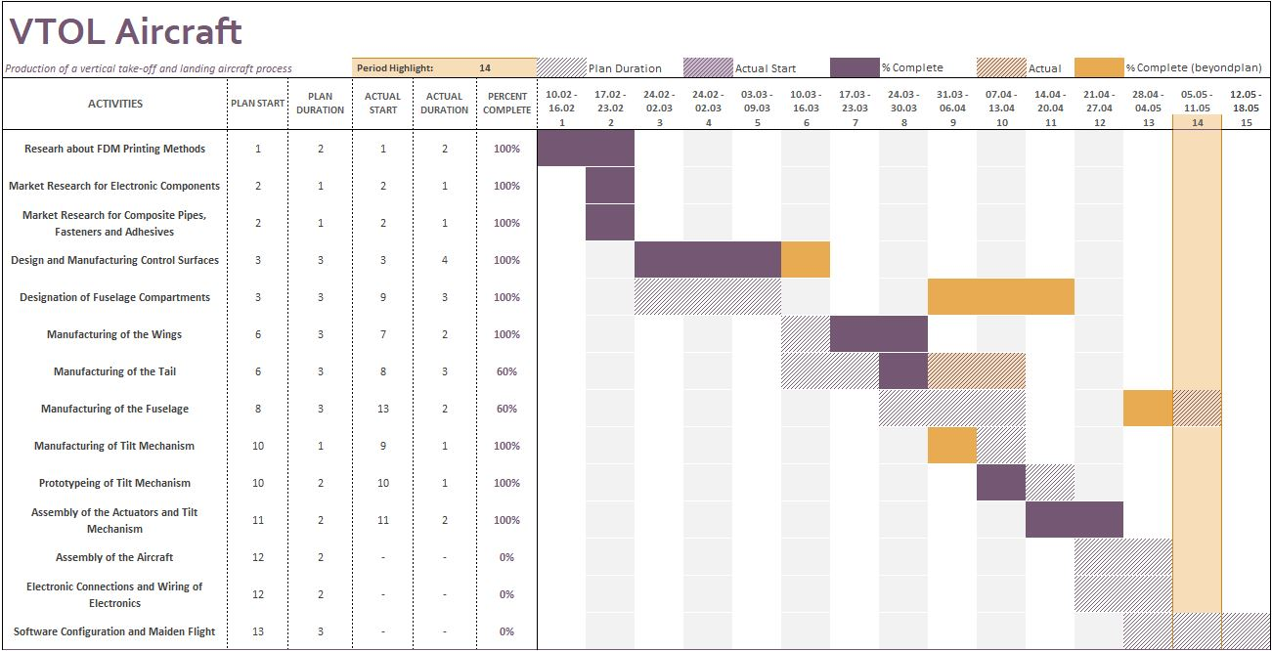
Gannt Chard

